Slide 1
Exoplanet Detection Methods
Kolya Larson, Matt Lastovka, Cassie Moats, Sam Eckart

Slide 2
Motivation
Different methods of detection have different effectivenesses, limitations, and biases
Understand the way planets are distributed in various parameter spaces
Determine detection signals for a Jupiter-like planet around a sun-like star

Slide 3
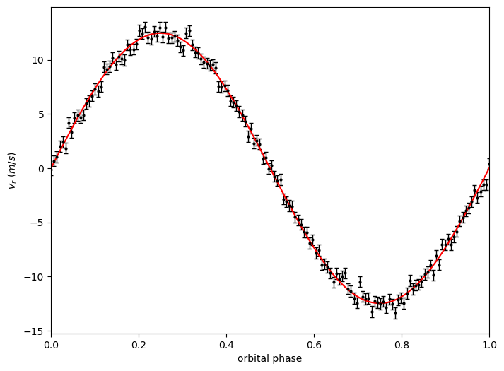
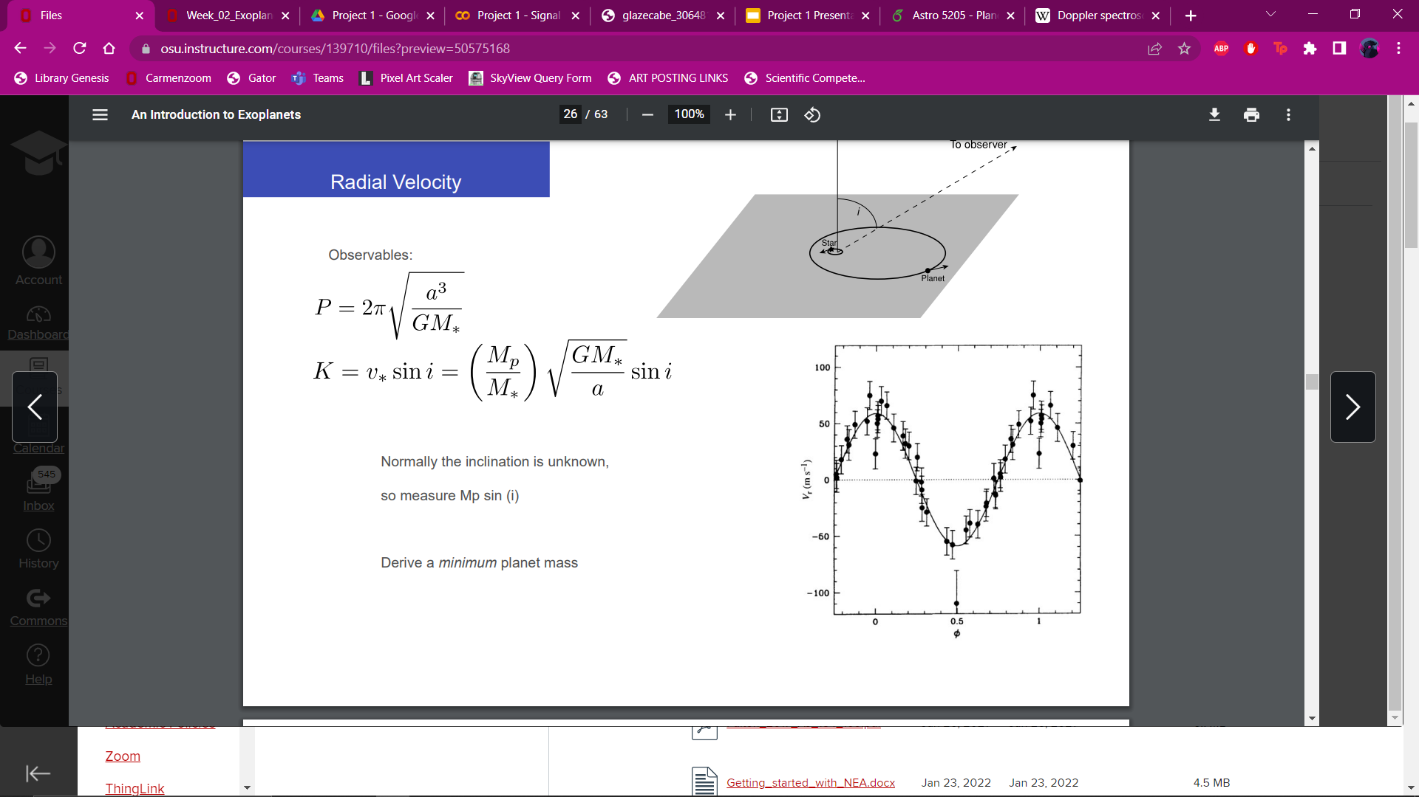
Radial Velocity (RV)
Planets cause their host stars to
“wobble” periodically
Credit: Week 2 Exoplanet Detection and Population powerpoint

Slide 4
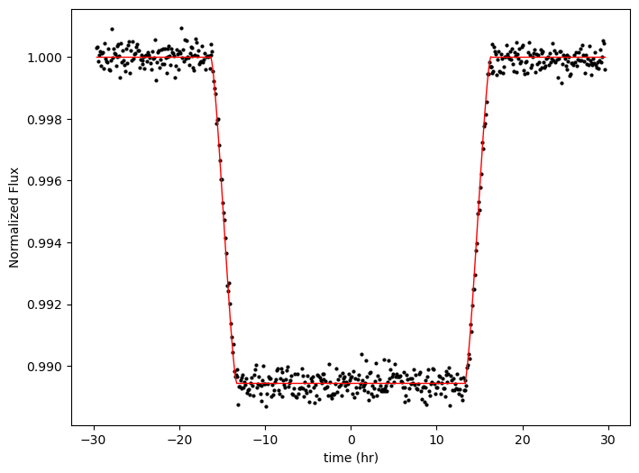
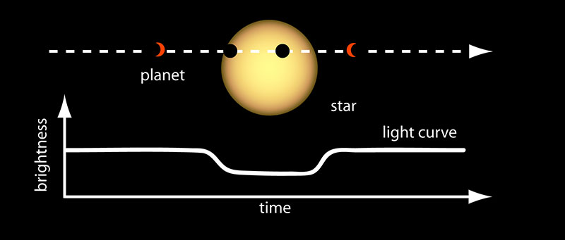
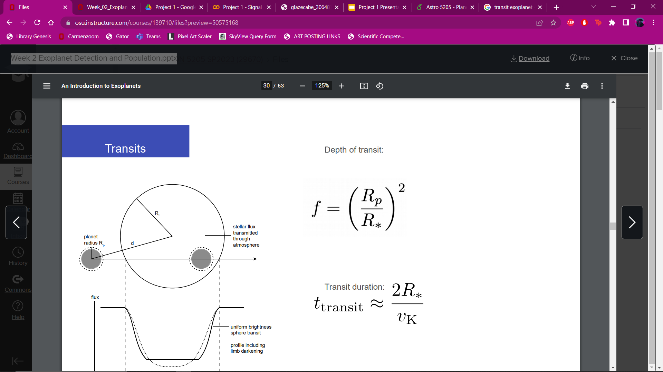
Transit
Planet passes in front of its host
star, causing a dip in brightness
Credit: NASA, Week 2 Exoplanet Detection and Population powerpoint

Slide 5
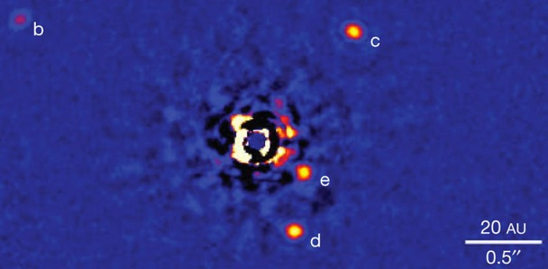
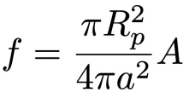
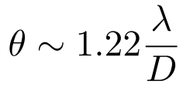
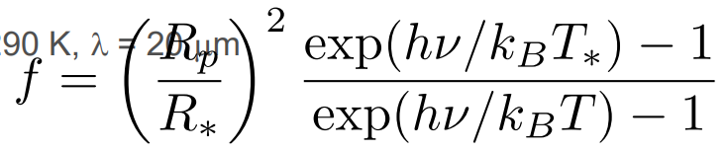
Direct Imaging
Directly view an exoplanet by
removing its host star’s glare
Credit: Marois et al (2010), Week 2 Exoplanet Detection and Population powerpoint

Slide 6
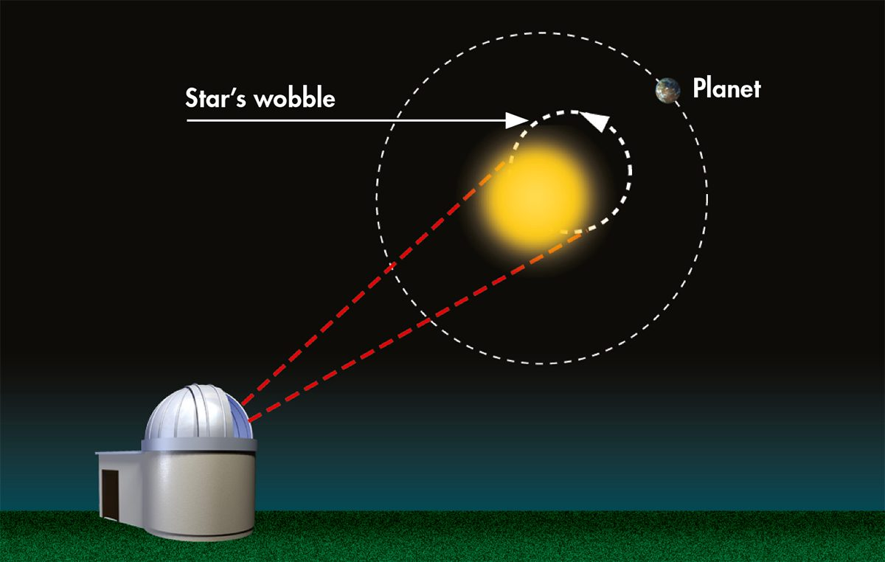
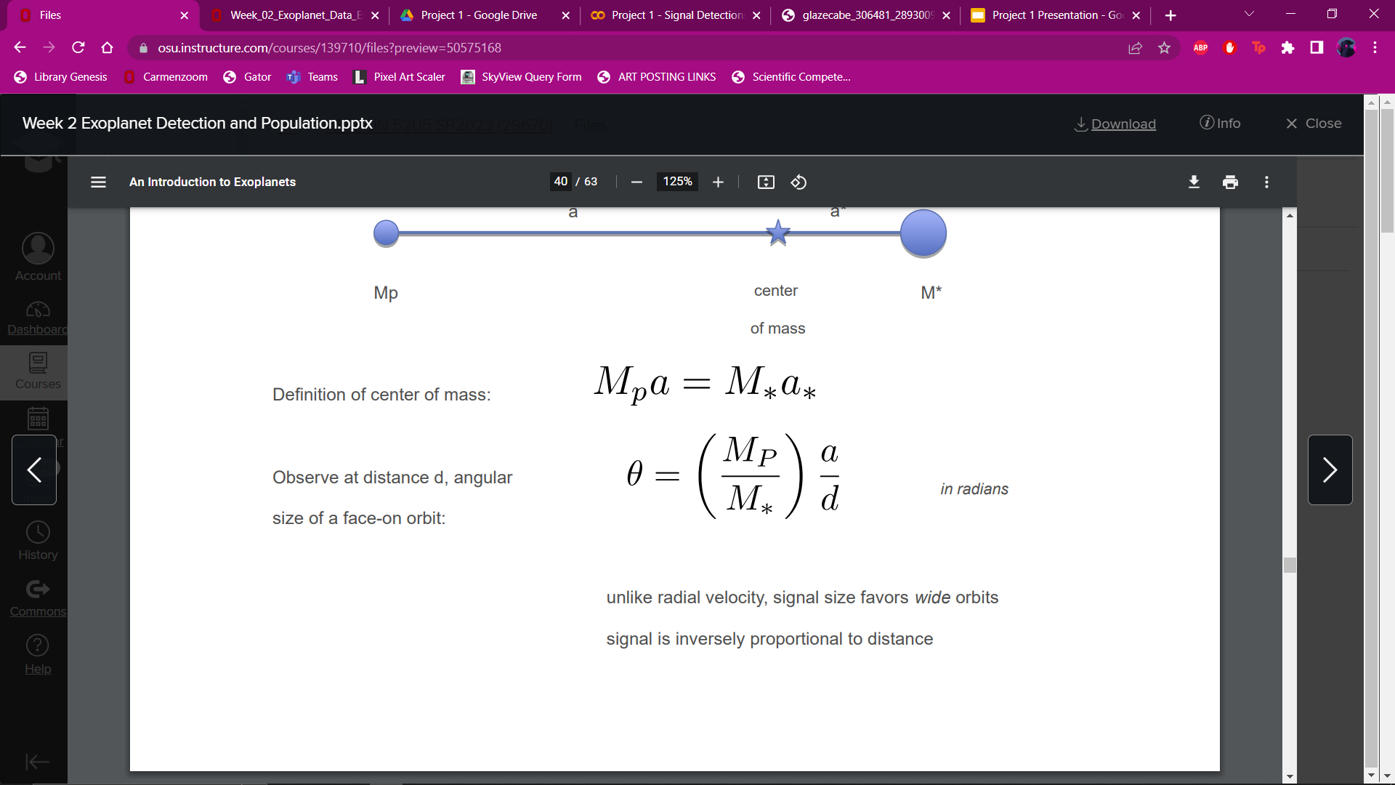
Astrometry
Detect angular separation between a
planet and the star it orbits
Credit: BBC Sky at Night Magazine, Week 2 Exoplanet Detection and Population powerpoint

Slide 7
Did we find Jupiter?
Method | Is Jupiter detectable?
Radial Velocity | Yes
Transit | Yes
Direct Imaging | Maybe..?
Astrometry | No

Slide 8
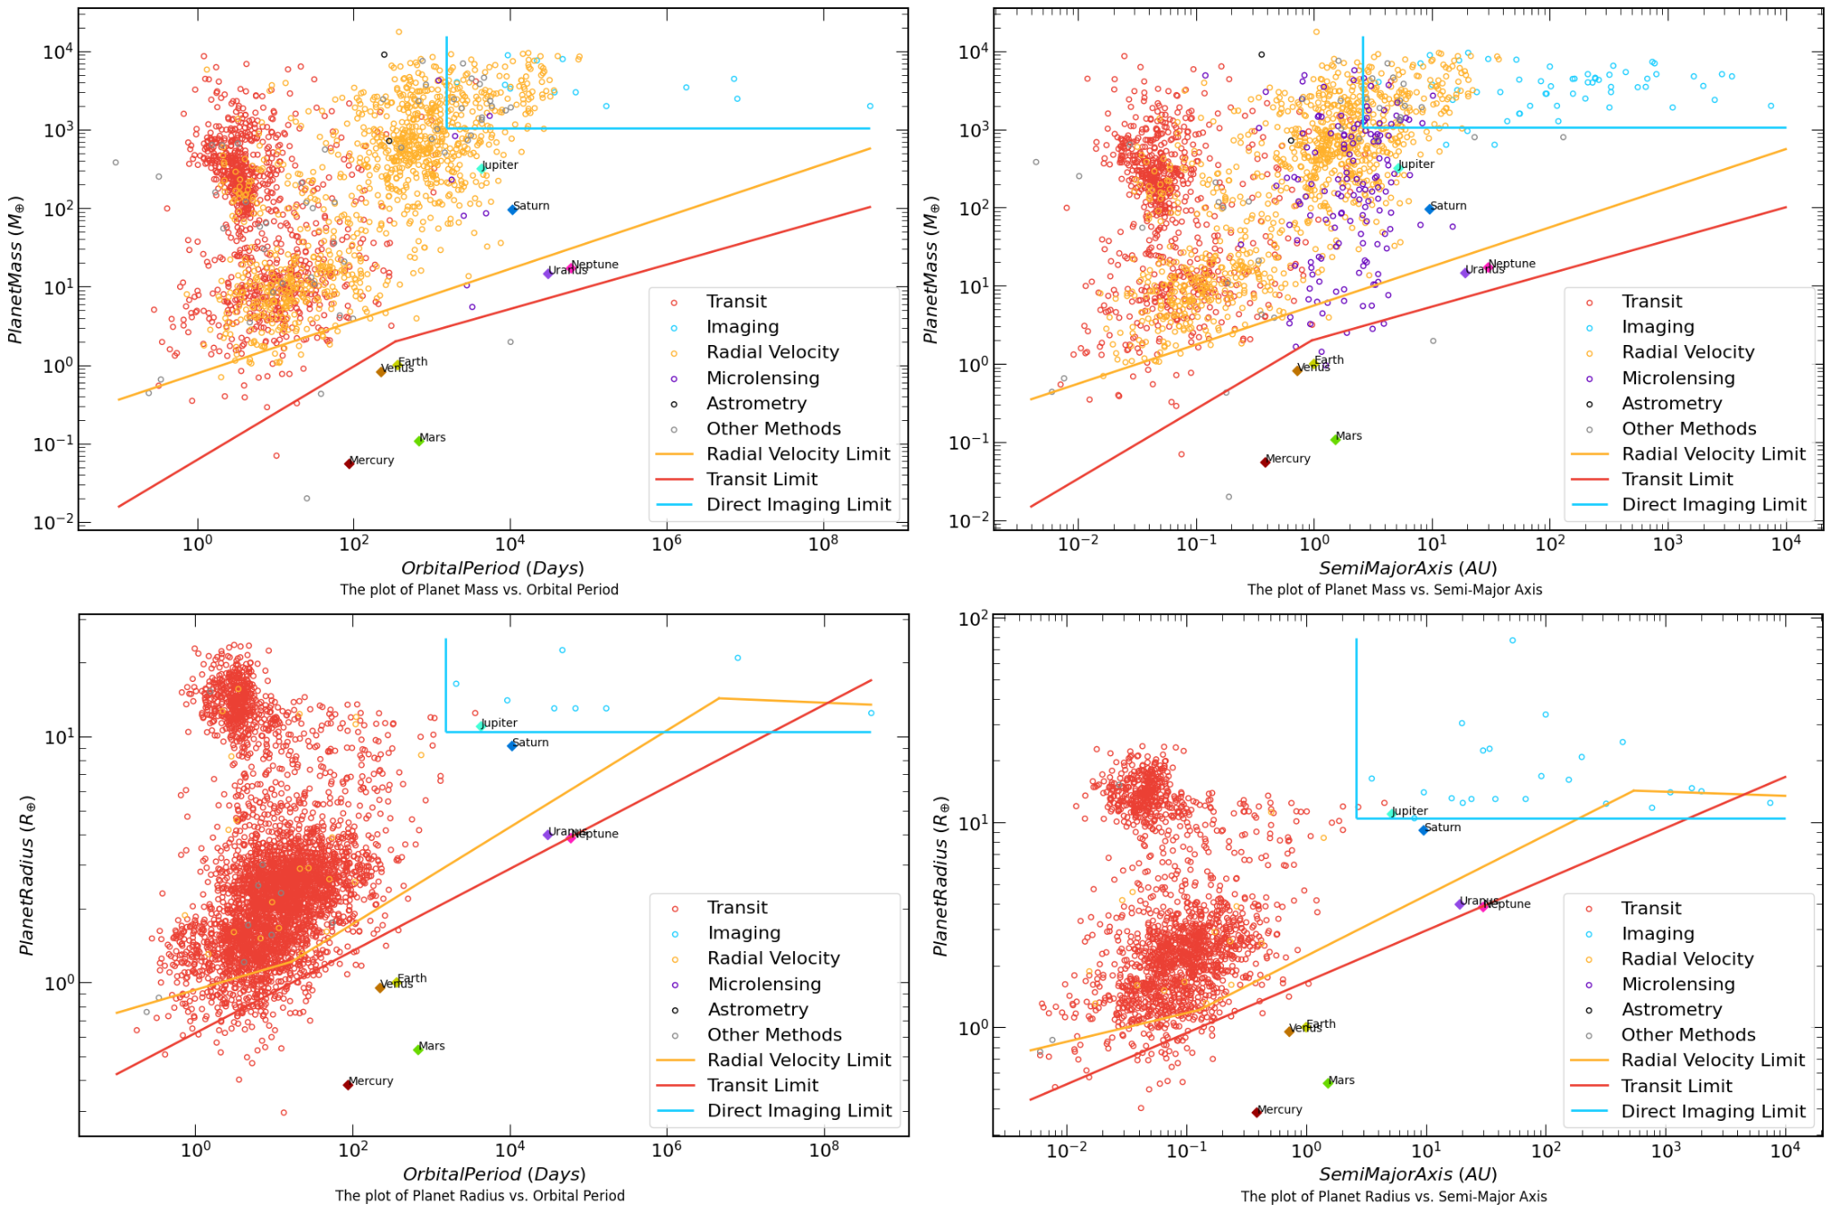
Notes:
These figures are placeholders until they are finished with the rest of the detection limits

Slide 9
Conclusions
Different exoplanet detection methods can be more or less effective in certain cases
Limitations of the methods incur biases
Plots of exoplanet data in different parameter spaces can teach us about the planetary evolutionary processes and distribution

